Slide 1
Simple Linear Regression

Slide 2
Correlation vs. Regression
A scatter plot can be used to show the relationship between two variables
Correlation analysis is used to measure the strength of the association (linear relationship) between two variables
  Correlation is only concerned with strength of the relationship
  No causal effect is implied with correlation
  Scatter plots were first presented in Ch. 2
  Correlation was first presented in Ch. 3

Slide 3
Regression Models
Linear relationships
Curvilinear relationships
Y
Y
X
X
Y
Y
X
X

Slide 4
Types of Relationships
(continued)
Strong relationships
Weak relationships
Y
Y
X
X
Y
Y
X
X

Slide 5
Types of Relationships
(continued)
No relationship
Y
X
Y
X

Slide 6
Introduction to Regression Analysis
Regression analysis is used to:
  Predict the value of a dependent variable based on the value of at least one independent variable
  Explain the impact of changes in an independent variable on the dependent variable
Dependent variable: the variable we wish to
predict or explain
Independent variable: the variable used to predict or explain the dependent variable

Slide 7
Simple Linear Regression Model
Only one independent variable, X
Relationship between X and Y is described by a linear function
Changes in Y are assumed to be related to changes in X

Slide 8
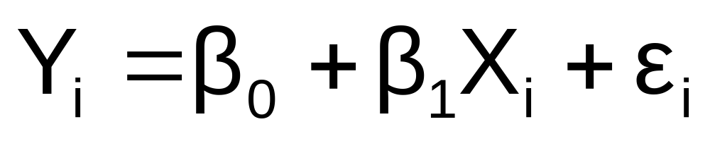
Simple Linear Regression Model
Population Slope
Coefficient
Random Error term
Population
Y intercept
Independent Variable
Dependent Variable
Linear component
Random Error
component

Slide 9
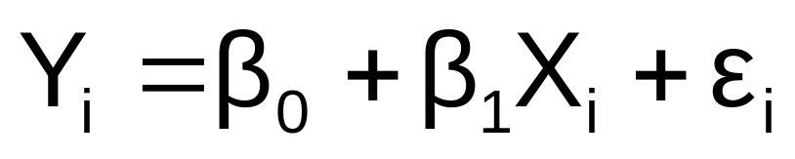
Simple Linear Regression
Model
(continued)
Y
Observed Value of Y for X_{i}
ε_{i}
Slope = β₁
Predicted Value of Y for X_{i}
Random Error for this X_{i} value
Intercept = β₀
X_{i}
X

Slide 10
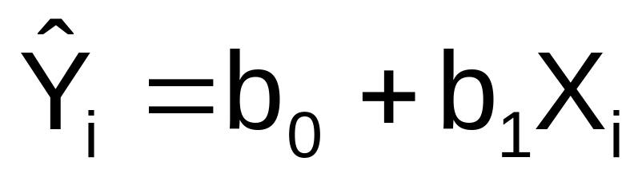
Simple Linear Regression Equation (Prediction Line)
The simple linear regression equation provides an estimate of the population regression line
Estimated (or predicted) Y value for observation i
Estimate of the regression
intercept
Estimate of the regression slope
Value of X for observation i

Slide 11
The Least Squares Method
b₀ and b₁ are obtained by finding the values that minimize the sum of the squared differences between Y and Y :
∧

Slide 12
Finding the Least Squares Equation
The coefficients b₀ and b₁, and other regression results in this chapter, will be found using Excel or Minitab
Formulas are shown in the text for those who are interested

Slide 13
Interpretation of the
Slope and the Intercept
b₀ is the estimated mean value of Y when the value of X is zero
b₁ is the estimated change in the mean value of Y as a result of a one-unit increase in X

Slide 14

Simple Linear Regression
Example
A real estate agent wishes to examine the relationship between the selling price of a home and its size (measured in square feet)
A random sample of 10 houses is selected
  Dependent variable (Y) = house price in $1000s
  Independent variable (X) = square feet

Slide 15
Simple Linear Regression Example: Data
House Price in $1000s (Y) | Square Feet (X)
245 | 1400
312 | 1600
279 | 1700
308 | 1875
199 | 1100
219 | 1550
405 | 2350
324 | 2450
319 | 1425
255 | 1700

Slide 16
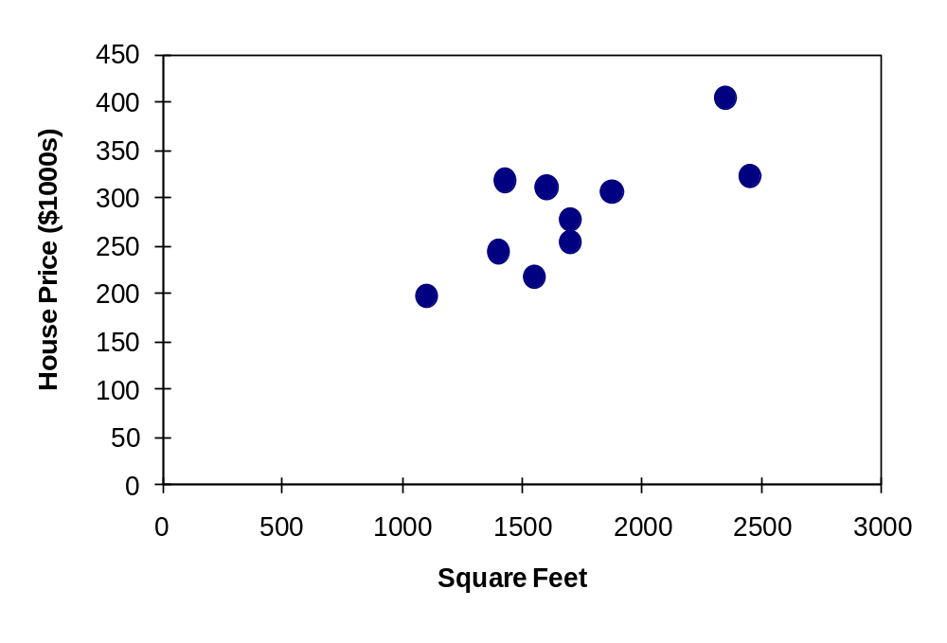
Simple Linear Regression Example: Scatter Plot
House price model: Scatter Plot

Slide 17
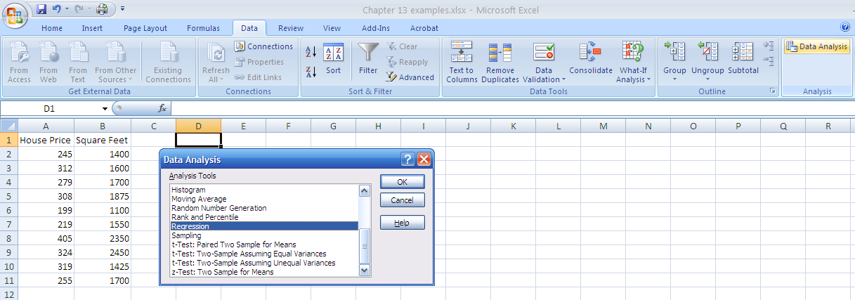
Simple Linear Regression Example: Using Excel Data Analysis Function
1. Choose Data
2. Choose Data Analysis
3. Choose Regression

Slide 18
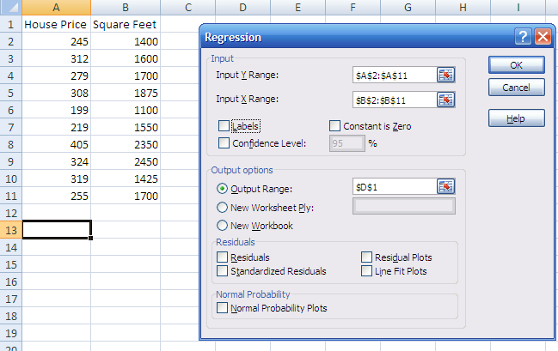
Simple Linear Regression Example: Using Excel Data Analysis Function
(continued)
Enter Y range and X range and desired options

Slide 19
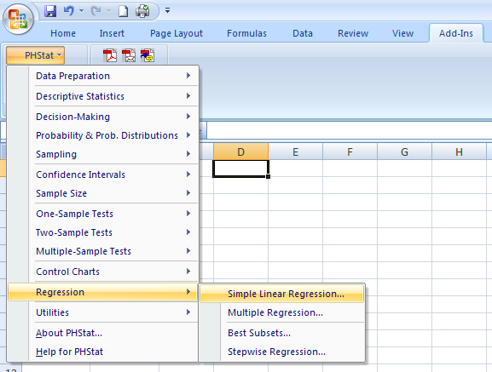
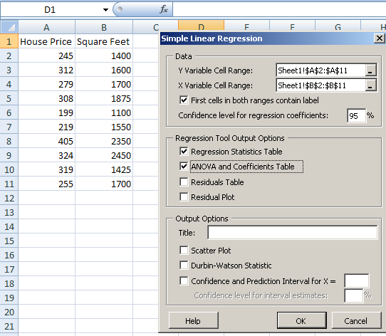
Simple Linear Regression Example: Using PHStat
Add-Ins: PHStat: Regression: Simple Linear Regression

Slide 20
Simple Linear Regression Example: Excel Output
Regression Statistics
Multiple R | 0.76211
R Square | 0.58082
Adjusted R Square | 0.52842
Standard Error | 41.33032
Observations | 10
ANOVA | df | SS | MS | F | Significance F
Regression | 1 | 18934.9348 | 18934.9348 | 11.0848 | 0.01039
Residual | 8 | 13665.5652 | 1708.1957
Total | 9 | 32600.5000
 | Coefficients | Standard Error | t Stat | P-value | Lower 95% | Upper 95%
Intercept | 98.24833 | 58.03348 | 1.69296 | 0.12892 | -35.57720 | 232.07386
Square Feet | 0.10977 | 0.03297 | 3.32938 | 0.01039 | 0.03374 | 0.18580
The regression equation is:

Slide 21
Simple Linear Regression Example: Minitab Output
The regression equation is:
The regression equation is
Price = 98.2 + 0.110 Square Feet
Predictor Coef SE Coef T P
Constant 98.25 58.03 1.69 0.129
Square Feet 0.10977 0.03297 3.33 0.010
S = 41.3303 R-Sq = 58.1% R-Sq(adj) = 52.8%
Analysis of Variance
Source DF SS MS F P
Regression 1 18935 18935 11.08 0.010
Residual Error 8 13666 1708
Total 9 32600
house price = 98.24833 +
0.10977 (square feet)

Slide 22
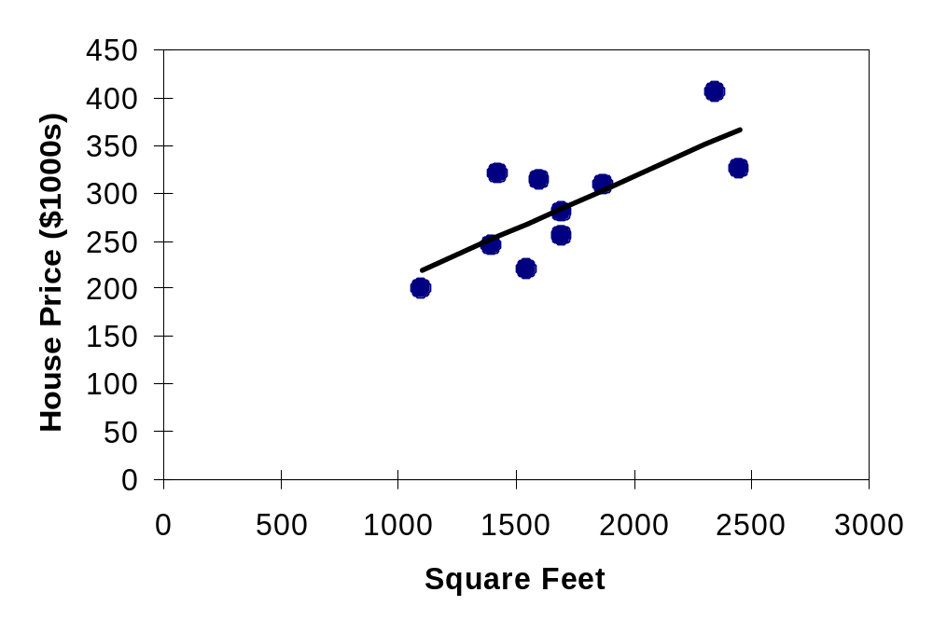
Simple Linear Regression Example: Graphical Representation
House price model: Scatter Plot and Prediction Line
Slope
= 0.10977
Intercept
= 98.248

Slide 23
Simple Linear Regression Example: Interpretation of b_{o}
b₀ is the estimated mean value of Y when the value of X is zero (if X = 0 is in the range of observed X values)
Because a house cannot have a square footage of 0, b₀ has no practical application

Slide 24
Simple Linear Regression Example: Interpreting b₁
b₁ estimates the change in the mean value of Y as a result of a one-unit increase in X
  Here, b₁ = 0.10977 tells us that the mean value of a house increases by .10977($1000) = $109.77, on average, for each additional one square foot of size

Slide 25
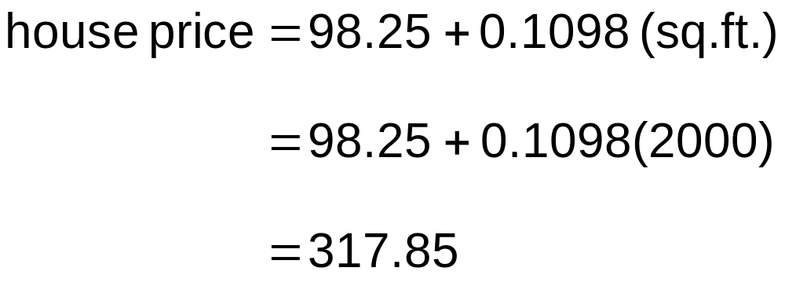
Simple Linear Regression Example: Making Predictions
Predict the price for a house with 2000 square feet:
The predicted price for a house with 2000 square feet is 317.85($1,000s) = $317,850

Slide 26
Simple Linear Regression Example: Making Predictions
When using a regression model for prediction, only predict within the relevant range of data
Relevant range for interpolation
Do not try to extrapolate beyond the range of observed X’s

Slide 27
Assumptions of Regression
L.I.N.E
Linearity
  The relationship between X and Y is linear
Independence of Errors
  Error values are statistically independent
  Particularly important when data are collected over a period of time
Normality of Error
  Error values are normally distributed for any given value of X
Equal Variance (also called homoscedasticity)
  The probability distribution of the errors has constant variance

Slide 28
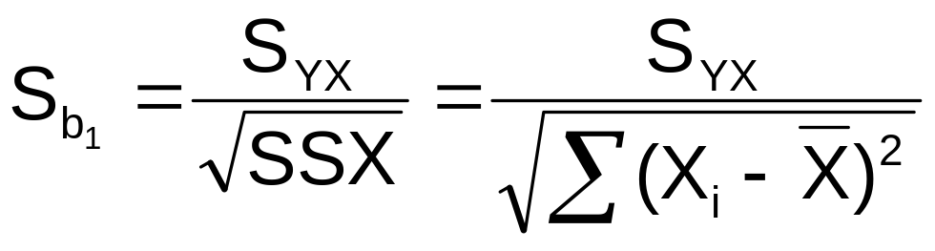
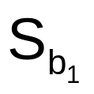
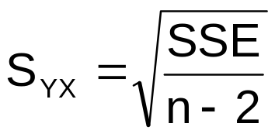
Inferences About the Slope
The standard error of the regression slope coefficient (b₁) is estimated by
where:
= Estimate of the standard error of the slope
= Standard error of the estimate

Slide 29
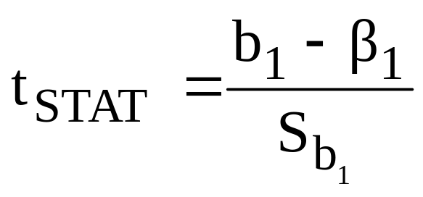

Inferences About the Slope: t Test
t test for a population slope
  Is there a linear relationship between X and Y?
Null and alternative hypotheses
  H₀: β₁ = 0 (no linear relationship)
  H₁: β₁ ≠ 0 (linear relationship does exist)
Test statistic
where:
b₁ = regression slope
coefficient
β₁ = hypothesized slope
S_{b1} = standard
error of the slope

Slide 30
Inferences About the Slope: t Test Example
Estimated Regression Equation:
House Price in $1000s (y) | Square Feet (x)
245 | 1400
312 | 1600
279 | 1700
308 | 1875
199 | 1100
219 | 1550
405 | 2350
324 | 2450
319 | 1425
255 | 1700
house price = 98.25 + 0.1098 (sq. ft.)
The slope of this model is 0.1098
Is there a relationship between the square footage of the house and its sales price?

Slide 31
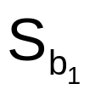
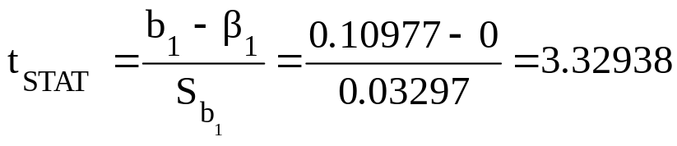
Inferences About the Slope: t Test Example
H₀: β₁ = 0
H₁: β₁ ≠ 0
From Excel output:
 | Coefficients | Standard Error | t Stat | P-value
Intercept | 98.24833 | 58.03348 | 1.69296 | 0.12892
Square Feet | 0.10977 | 0.03297 | 3.32938 | 0.01039
From Minitab output:
b₁
Predictor Coef SE Coef T P
Constant 98.25 58.03 1.69 0.129
Square Feet 0.10977 0.03297 3.33 0.010
b₁

Slide 32
Inferences About the Slope: t Test Example
H₀: β₁ = 0
H₁: β₁ ≠ 0
Test Statistic: t_{STAT} = 3.329
d.f. = 10- 2 = 8
Decision: Reject H₀
α/2=.025
α/2=.025
There is sufficient evidence that square footage affects house price
Reject H₀
Do not reject H₀
Reject H₀
-t_{α/2}
t_{α/2}
0
-2.3060
2.3060
3.329

Slide 33
Inferences About the Slope: t Test Example
H₀: β₁ = 0
H₁: β₁ ≠ 0
From Excel output:
 | Coefficients | Standard Error | t Stat | P-value
Intercept | 98.24833 | 58.03348 | 1.69296 | 0.12892
Square Feet | 0.10977 | 0.03297 | 3.32938 | 0.01039
From Minitab output:
Predictor Coef SE Coef T P
Constant 98.25 58.03 1.69 0.129
Square Feet 0.10977 0.03297 3.33 0.010
p-value
Decision: Reject H₀, since p-value < α
There is sufficient evidence that square footage affects house price.

Slide 34
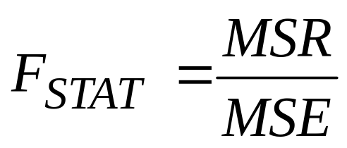
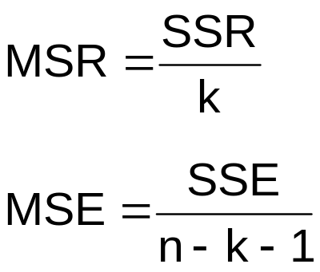
F Test for Significance
F Test statistic:
where
where F_{STAT} follows an F distribution with k numerator and (n – k - 1) denominator degrees of freedom
(k = the number of independent variables in the regression model)

Slide 35
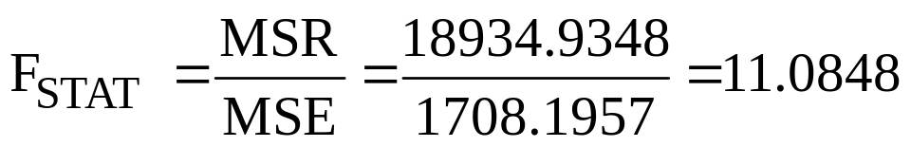
F-Test for Significance
Excel Output
Regression Statistics
Multiple R | 0.76211
R Square | 0.58082
Adjusted R Square | 0.52842
Standard Error | 41.33032
Observations | 10
ANOVA | df | SS | MS | F | Significance F
Regression | 1 | 18934.9348 | 18934.9348 | 11.0848 | 0.01039
Residual | 8 | 13665.5652 | 1708.1957
Total | 9 | 32600.5000
With 1 and 8 degrees of freedom
p-value for the F-Test

Slide 36
F-Test for Significance
Minitab Output
Analysis of Variance
Source DF SS MS F P
Regression 1 18935 18935 11.08 0.010
Residual Error 8 13666 1708
Total 9 32600
p-value for the F-Test
With 1 and 8 degrees of freedom

Slide 37
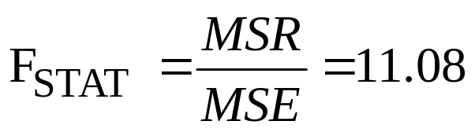
F Test for Significance
(continued)
Test Statistic:
Decision:
Conclusion:
H₀: β₁ = 0
H₁: β₁ ≠ 0
α = .05
df₁= 1 df₂ = 8
Critical Value:
F_{α} = 5.32
Reject H₀ at α = 0.05
α = .05
There is sufficient evidence that house size affects selling price
0
F
Do not
reject H₀
Reject H₀
F_{.05} = 5.32

Slide 38
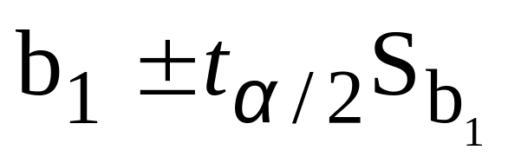
Confidence Interval Estimate for the Slope
Confidence Interval Estimate of the Slope:
d.f. = n - 2
Excel Printout for House Prices:
 | Coefficients | Standard Error | t Stat | P-value | Lower 95% | Upper 95%
Intercept | 98.24833 | 58.03348 | 1.69296 | 0.12892 | -35.57720 | 232.07386
Square Feet | 0.10977 | 0.03297 | 3.32938 | 0.01039 | 0.03374 | 0.18580
At 95% level of confidence, the confidence interval for the slope is (0.0337, 0.1858)

Slide 39
Confidence Interval Estimate for the Slope
(continued)
 | Coefficients | Standard Error | t Stat | P-value | Lower 95% | Upper 95%
Intercept | 98.24833 | 58.03348 | 1.69296 | 0.12892 | -35.57720 | 232.07386
Square Feet | 0.10977 | 0.03297 | 3.32938 | 0.01039 | 0.03374 | 0.18580
Since the units of the house price variable is $1000s, we are 95% confident that the average impact on sales price is between $33.74 and $185.80 per square foot of house size
This 95% confidence interval does not include 0.
Conclusion: There is a significant relationship between house price and square feet at the .05 level of significance

Slide 40
Confidence Interval Estimate for the Slope from Minitab
(continued)
Minitab does not automatically calculate a confidence
interval for the slope but provides the quantities necessary
to use the confidence interval formula.
Predictor Coef SE Coef T P
Constant 98.25 58.03 1.69 0.129
Square Feet 0.10977 0.03297 3.33 0.010

Slide 41
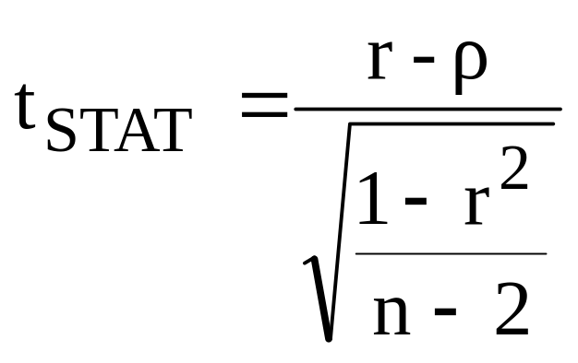
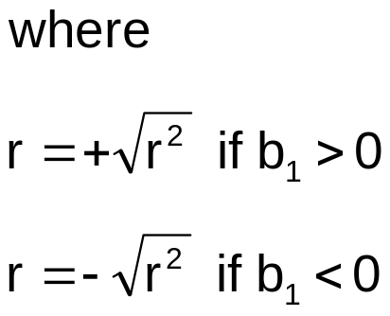
t Test for a Correlation Coefficient
Hypotheses
  H₀: ρ = 0 (no correlation between X and Y)
  H₁: ρ ≠ 0 (correlation exists)
Test statistic
  (with n – 2 degrees of freedom)

Slide 42
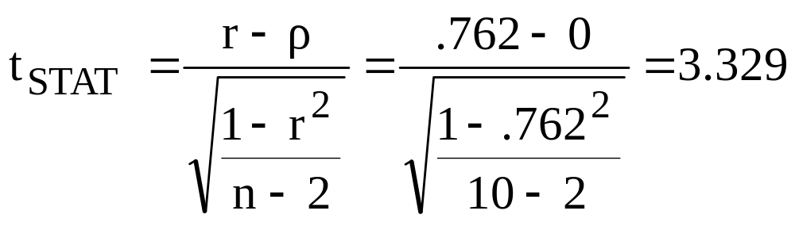
t-test For A Correlation Coefficient
(continued)
Is there evidence of a linear relationship between square feet and house price at the .05 level of significance?
H₀: ρ = 0 (No correlation)
H₁: ρ ≠ 0 (correlation exists)
α =.05 , df = 10 - 2 = 8

Slide 43
t-test For A Correlation Coefficient
(continued)
Decision:
Reject H₀
Conclusion:
There is evidence of a linear association at the 5% level of significance
d.f. = 10-2 = 8
α/2=.025
α/2=.025
Reject H₀
-t_{α/2}
Do not reject H₀
t_{α/2}
Reject H₀
0
-2.3060
2.3060
3.329

